Slide 1


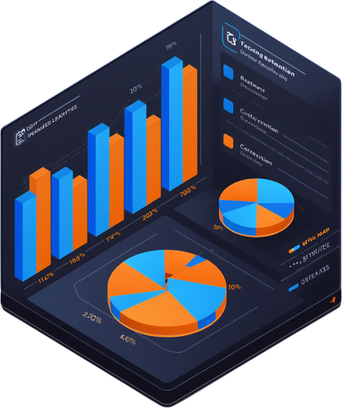

Presented byANUBHAV ROY | 2026
CUSTOMER CHURN ANALYSIS
FOR TELECOM
Statistical Analysis, Predictive Modeling & Retention Strategies
ANUBHAV ROY
MSc Statistics

Slide 2
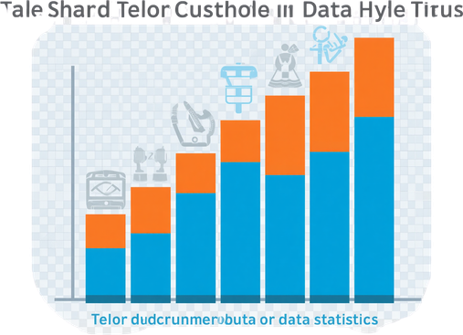

PROJECT OVERVIEW & DATASET
Context & Scope of
the Churn Analysis
Dataset: 7,043 customers, 21 variables
Variables: demographics, services & billing
Target variable: customer churn status
Objective: identify key churn drivers
Goal: build a reliable predictive model

Slide 3

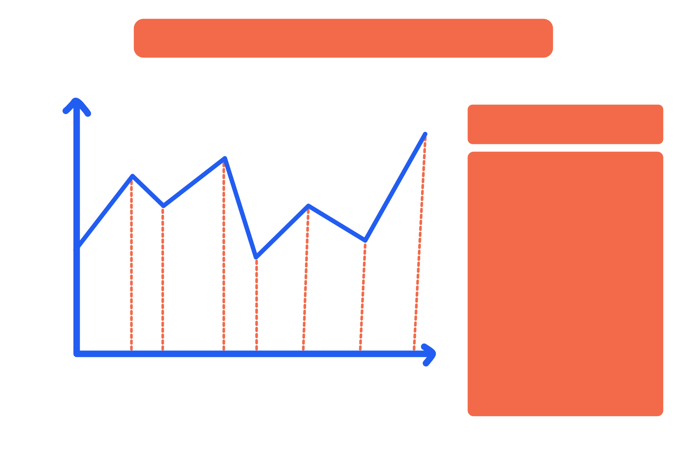
CHURN
OVERVIEW
27% Churned, 73% Retained
Customer churn represents a significant revenue loss. With over a quarter of customers leaving, understanding churn drivers is critical to protecting long-term business growth and improving customer lifetime value.

Slide 4

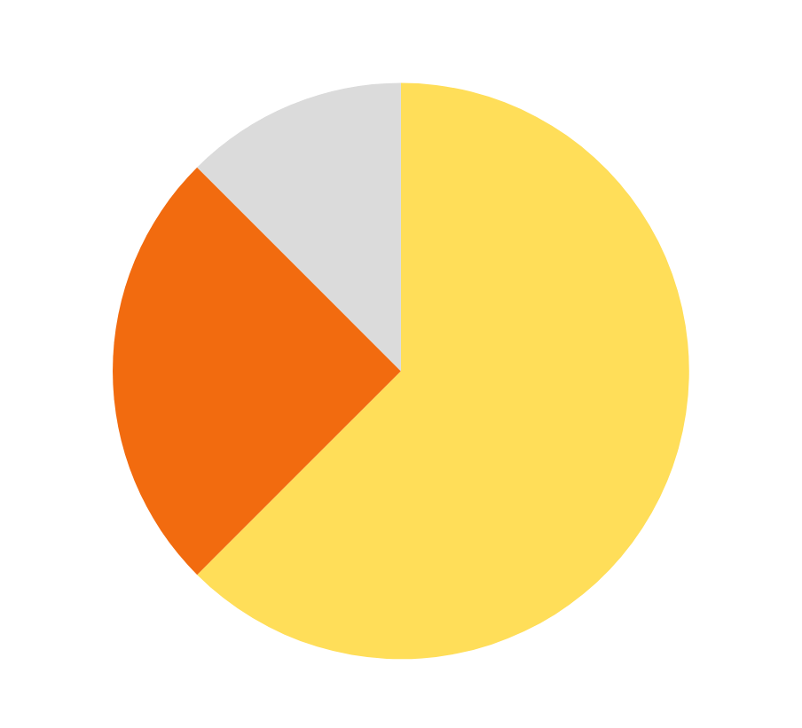
CUSTOMER
SEGMENTS
BREAKDOWN
Contract Types & Internet Services
54% of customers are on month-to-month contracts, the highest churn risk segment. Only 22.75% hold two-year contracts. For internet services, 43% use Fiber optic and 34% use DSL.

Slide 5
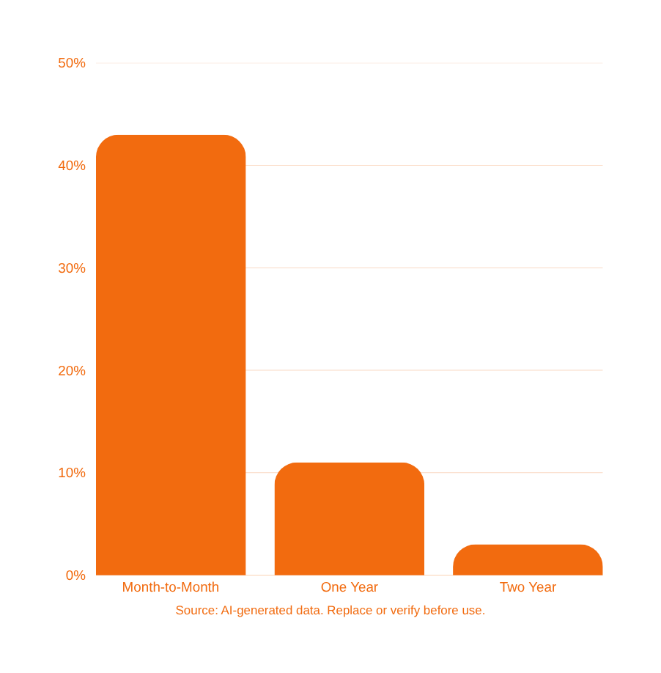
STATISTICAL ANALYSIS
CHI-SQUARE TEST
Contract Type vs. Churn (χ² = 1179.55, p < 0.001)
Contract type is significantly associated with churn. Month-to-month customers churn at ~43%, far exceeding one-year (11%) and two-year (3%) contracts. The chi-square test confirms this is not due to chance.

Slide 6


STATISTICAL
ANALYSIS –
WELCH'S T-TEST
Monthly Charges: Key Differentiator
Welch's t-test reveals a statistically significant difference in monthly charges between churned and retained customers (t = 16.48, p < 0.001). Churned customers pay higher monthly charges on average, indicating pricing sensitivity as a primary churn driver.

Slide 7


KEY PATTERNS IDENTIFIED
Behavioral & Demographic
Differences (Part 1)
Churned customers have significantly shorter tenure
Early-stage customers are at the highest churn risk
Month-to-month contracts show the highest churn rate
Long-term contracts strongly linked to retention
Retained customers accumulate higher total charges

Slide 8
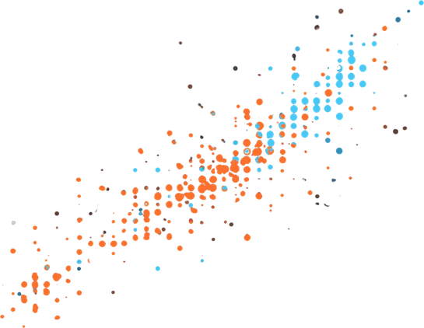

KEY PATTERNS (PART 2)
Additional Correlations &
Churn Insights
Churned customers have higher average monthly charges
Strong correlation: tenure vs. total charges (r = 0.83)
Longer tenure customers generate significantly higher total revenue
High monthly charges signal elevated churn risk segments
Tenure is the strongest predictor of customer lifetime value

Slide 9

METHODOLOGY
OVERVIEW
Stepwise Approach to Analysis & Predictive Modeling
Data Preprocessing → Handling missing values & encoding variables
Exploratory Data Analysis → Uncovering patterns and distributions
Statistical Hypothesis Testing → Chi-Square & Welch's t-Test
Logistic Regression → Building baseline predictive churn model
Model Evaluation → Accuracy, Precision, Recall, F1 & ROC-AUC

Slide 10


PREDICTIVE
MODELING
APPROACH
Logistic Regression
Baseline Model
Features: demographics, services & billing variables. Target: Churn (Yes/No). Model selected for interpretability and strong baseline performance with ROC-AUC of 0.828.

Slide 11



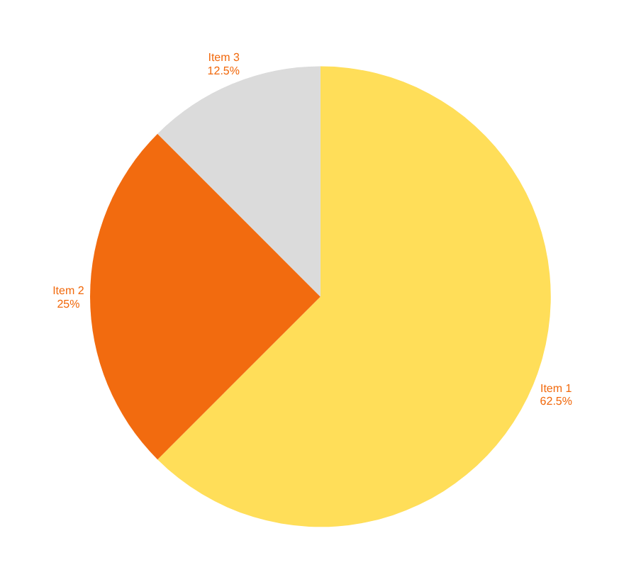
MODEL PERFORMANCE
METRICS
Logistic Regression Evaluation Results
The model achieves 78.96% accuracy with a ROC-AUC of 0.828, demonstrating solid predictive power for identifying at-risk telecom customers.

Slide 12


BUSINESS INSIGHTS
Key Findings from Analysis
& Predictive Modeling
Contract type is a critical retention factor
Pricing strategy directly impacts churn decisions
Early customer engagement is crucial to retention
Longer-term contracts significantly encourage loyalty
High-value customers are also at risk of churning

Slide 13
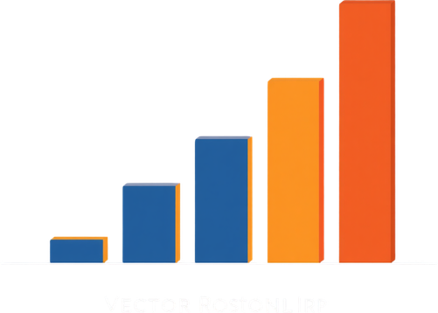

RETENTION STRATEGIES
Recommended Actions to
Reduce Customer Churn
Promote longer-term contract plans to reduce churn
Tailor pricing and offers to high-risk early tenure customers
Implement proactive engagement for new customers
Monitor high monthly charges as churn risk signals
Develop loyalty incentives for month-to-month subscribers

Slide 14

LIMITATIONS & CONSIDERATIONS
Critical Reflection on Data
& Model Constraints
Dataset based on fictional telecom company data
Class imbalance reduces model sensitivity for churn
Limited features: no satisfaction or competitor data
Logistic Regression is a baseline model only
Advanced models needed for improved prediction

